Slide 1
Eve in the Time of Twain
Dr. Ariel C. Silver
Park Church Summer Lecture Series 2022
ariel.silver@gmail.com

Slide 2
Eve
Auguste Rodin
1886
Art Institute of Chicago
After The Gates of Hell
1880

Slide 3
Adam and Eve
Edvard Munch
1909
Munch Museum

Slide 4
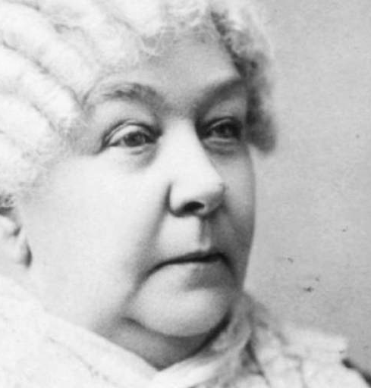
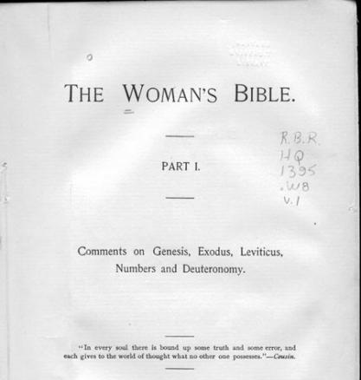

Slide 5
The Private Life of Adam and Eve
Harper & Brothers
1906

Slide 6
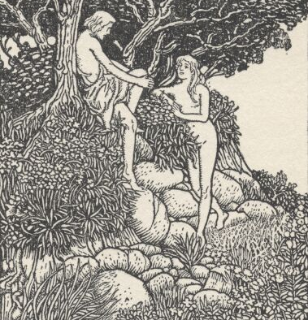
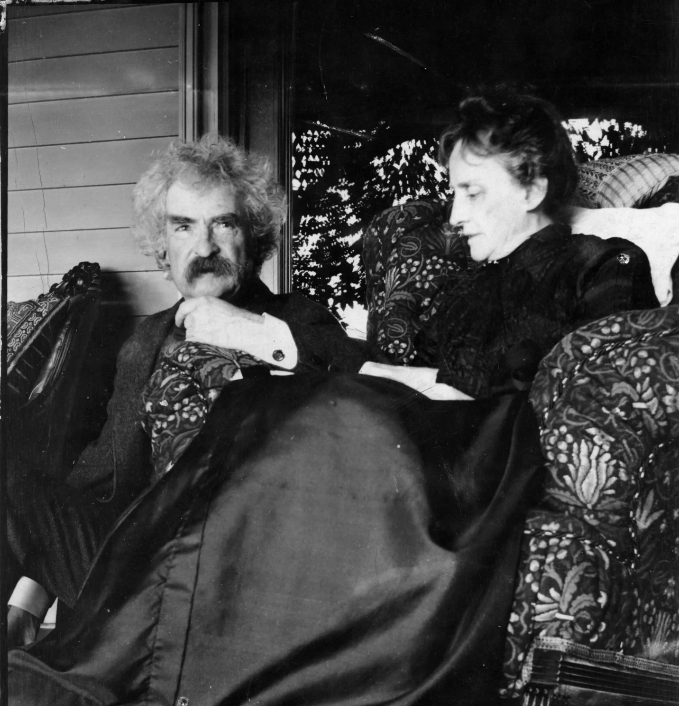

Slide 7
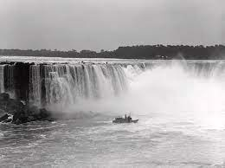
The Garden of Eden or “Niagara Falls Park”
Horseshow Falls at Niagara
c. 1900

Slide 8
“Queen of the Mist”
Annie Edson Taylor
Oct. 23, 1901
Went over Horseshoe Falls
in a barrel
“If I say I’ll do a thing, I’ll do it”

Slide 10
A Fortunate Fall
“It would be a deal more wonderful
to see it tumble up there”!”
(Extracts from Adam’s Diary, 53)

Slide 11
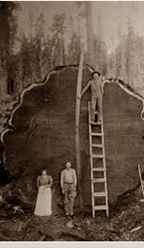
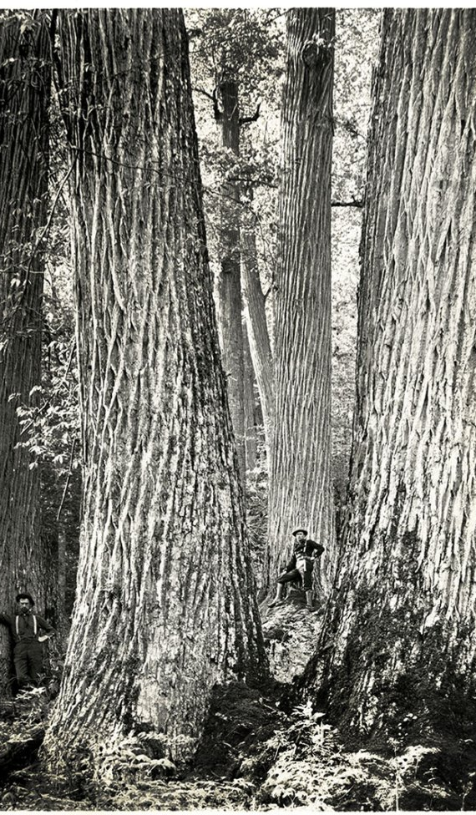

Slide 12
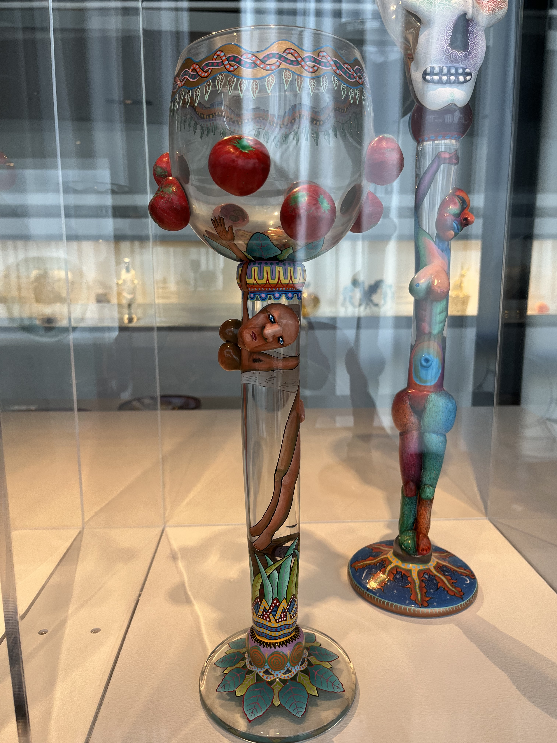

Slide 13
Eve’s First Sorrow
“But when night came I could not bear the lonesomeness, and went to the new shelter which he has built, to ask him what I had done that was wrong and how I could mend it and get back his kindness again; but he put me out in the rain, and it was my first sorrow”
(Eve’s Diary, 37)

Slide 14
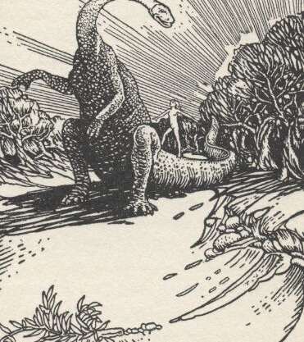
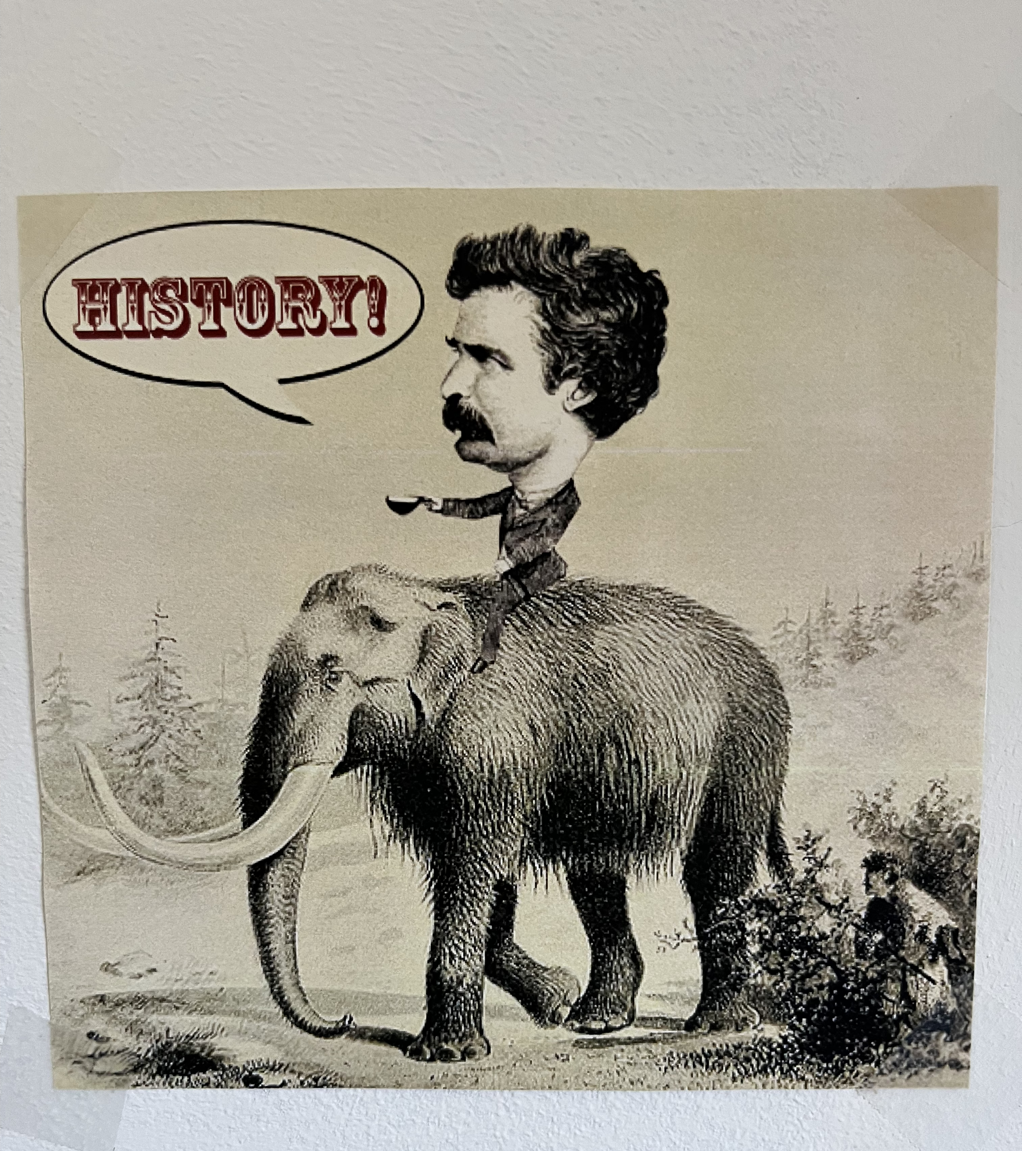

Slide 15
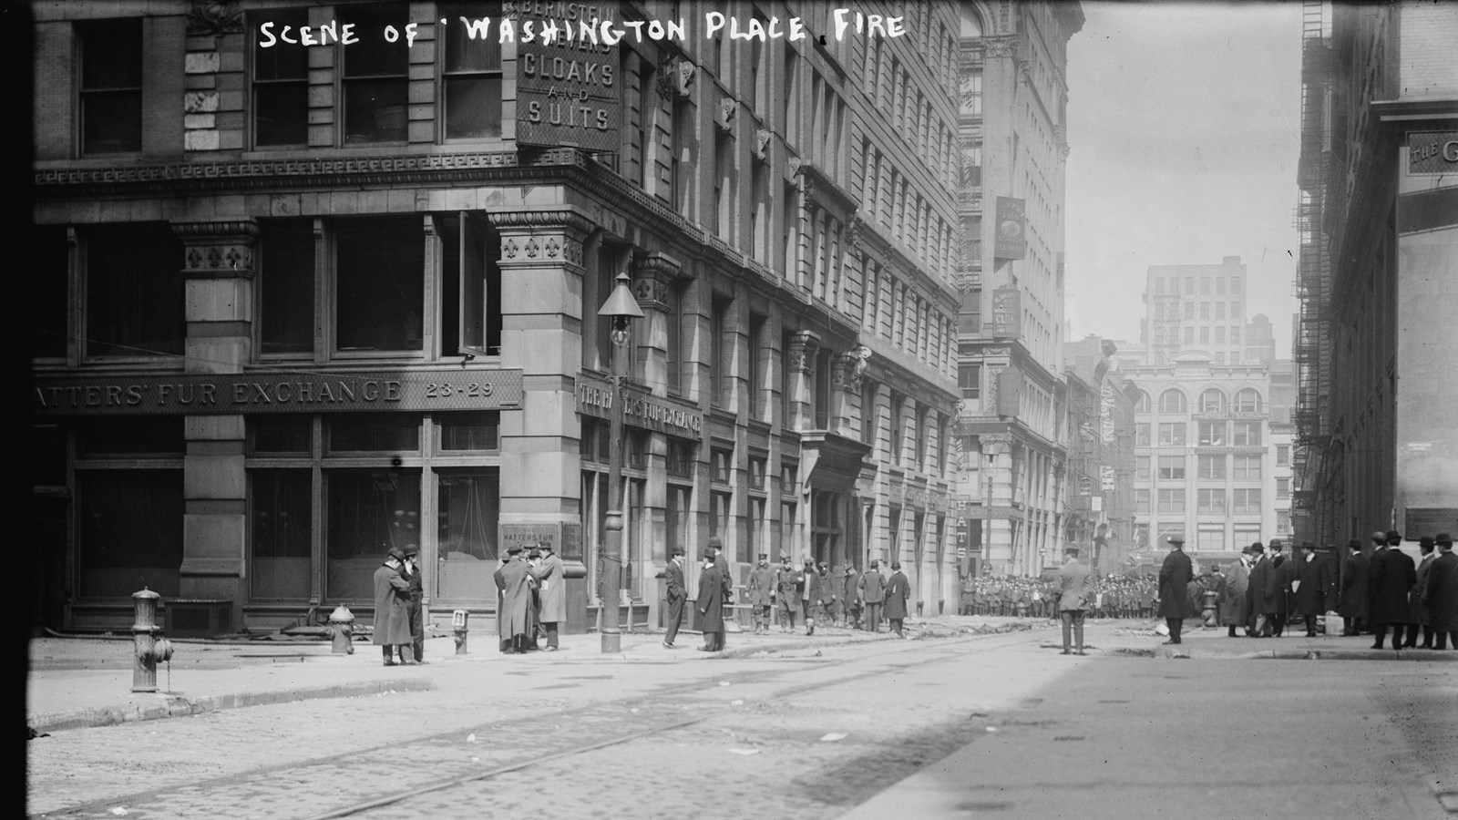

Slide 16
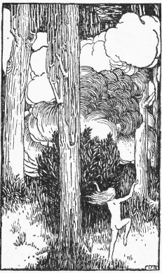
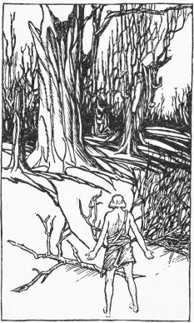

Slide 17
Olivia Langdon Clemens
“I am woman’s rights”
Olivia and Samuel Clemens to Mary Mason Fairbanks
22 March 1870
(Mark Twain Project Letters site)

Slide 18
Eve and Her Sister
“It talks when I talk; it is sad when I am sad; it comforts me with its sympathy; it says, ‘Do not be downhearted, you poor friendless girl; I will be your friend.’
It IS a good friend to me, and my only one; it is my sister.”
Eve’s Diary, 45

Slide 19
Suff-rage
prayers
requests for assistance
assistance provided by a supporting vote the vote itself
an inalienable right to vote
voting as a right rather than a privilege
Eve has such a “rage for explaining”
(Extracts from Adam’s Diary, 19)

Slide 20
Mark Twain on Anna Dickinson
“She talks fast, uses no notes what ever, never hesitates for a word, always gets the right word in the right place, and has the most perfect confidence in herself. Indeed, her sentences are remarkably smoothly-woven and felicitous. Her vim, her energy, her determined look, her tremendous earnestness, would compel the respect and the attention of an audience, even if she spoke in Chinese…”

Slide 21
The Suffragettes
Trixie Friganza
between other suffragettes
New York City
October 28, 1908

Slide 22
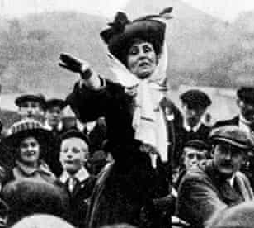
Emmeline Pankhurst
“Freedom or Death”
1913
Hartford, CT

Slide 23
Susan Brownell Anthony
“We had hoped that she might see the full fruition of her desires. All over the world there had been prayer without ceasing that she might remain until her dearest hope should become an established fact. But I believe I speak for all enlightened womanhood when I say that we almost forget the grief and disappointment in the prayer of thanksgiving that this great soul has been permitted to live even thus long and to give its splendid service to the world. We realize that her life has given to many nations a higher perception of life and duty and that it has lifted society to a higher plane, and we are grateful. We are rejoiced that she was permitted to make her life a continual and triumphal march of well-doing until the very end.”
Died in Rochester, NY
March 13, 1906
Excerpt from the eulogy delivered by
Carrie Chapman Catt
Founder of the Women Suffrage Party (precursor to League of Woman Voters)

Slide 24
At Eve’s Grave
“Wheresoever she was, there was Eden”
(Eve’s Diary 109)

Slide 25
