Slide 1
THE TERRA COMICA BETWEEN SHERMAN ALEXIE AND MARK TWAIN

Slide 2
“We had twenty-seven hundred pounds of [mail] aboard, the driver said—‘a little for Brigham, and Carson, and ’Frisco, but the heft of it for the Injuns, which is powerful troublesome ’thout they get plenty of truck to read.’
But as he just then got up a fearful convulsion of his countenance which was suggestive of a wink being swallowed by an earthquake, we guessed that his remark was intended to be facetious, and to mean that we would unload the most of our mail somewhere on the plains and leave it to the Indians, or whosoever wanted it.”
Roughing It, Chapter II

Slide 3
“The ‘territory’ of Roughing It emerges less as a region than a perspective…the West we discover is always and only our own creation.”
Lee Clark Mitchell, “Verbally Roughing It” (69)

Slide 4
As Twain goes farther and farther West, his arsenal of tall tales grows, and the myth of the West is subverted not by an attempt to excavate objective “truths,” but, unexpectedly, by the counterproliferation of myths.

Slide 5
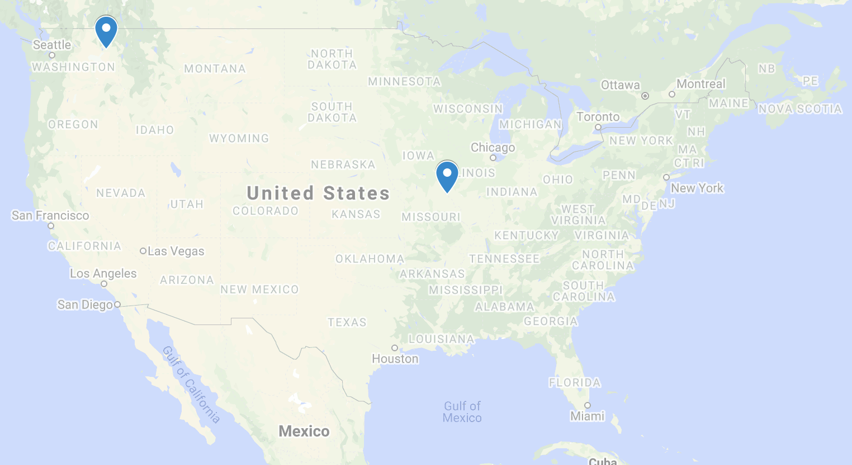
Spokane Indian Reservation
Hannibal
Sherman Alexie
(1966-)
Samuel Clemens
(1835-1910)

Slide 7
“Now I could give the reader a description of the Big Trees and the marvels of the Yo Semite—but what has the reader done to me that I should persecute him?”
“There might be five or six pine trees and a couple of rivers and streams, one grizzly bear and a lot of dogs, but that’s about all the flora and fauna you’re going to get.”
Roughing It, Chapter LXI
The Lone Ranger and Tonto Fistfight in Heaven, Introduction

Slide 8
Terra comica
“Native storytellers harness humor to reverse both external and internalized oppression, laughing at both the invaders and themselves.”
David Moore, That Dream Shall Have a Name (337)

Slide 9
“[Coyote] started jumping up and down because he was so mad. Then he accidentally dropped his toenail clippings over the side of the cloud and they fell to the earth. The clippings burrowed into the ground like seeds and grew up to be the white man. Coyote, he looked down at his newest creation and said, Oh, shit.
‘The whites are crazy, the whites are crazy,’ the children would chant and dance around Samuel in circles.
‘And sometimes so are the Indians,’ Samuel would whisper to himself.”
The Lone Ranger, “A Train Is an Order of Occurrence Designed to Lead to Some Result”

Slide 10
“they’re not really true…they’re necessarily biased, incomplete, exaggerated, deluded, and often just plain wrong.”
The Lone Ranger, Introduction

Slide 11
In both books, settings and characters matter less than the words that describe and inscribe them, and tall tales are exposed not by shortening or destroying them, but by enlarging and multiplying them. Thus, only on the hazardous precipice of unbelievability—on terra comica — can we begin to extend and even erase the “frontiers” that govern our minds.

Slide 12
Objectives
Show how Twain and Alexie forcibly eschew the unique physical terrain of the West and instead create a uniquely Western terra comica with multilayered humor, and polyvocal, cacophonous stories.
Argue that this terra comica—though often rocky and fraught—can still be a site conducive for conversation and possibly understanding about and between white and Indigenous peoples.

Slide 13
Thank you. Questions?

