Slide 1
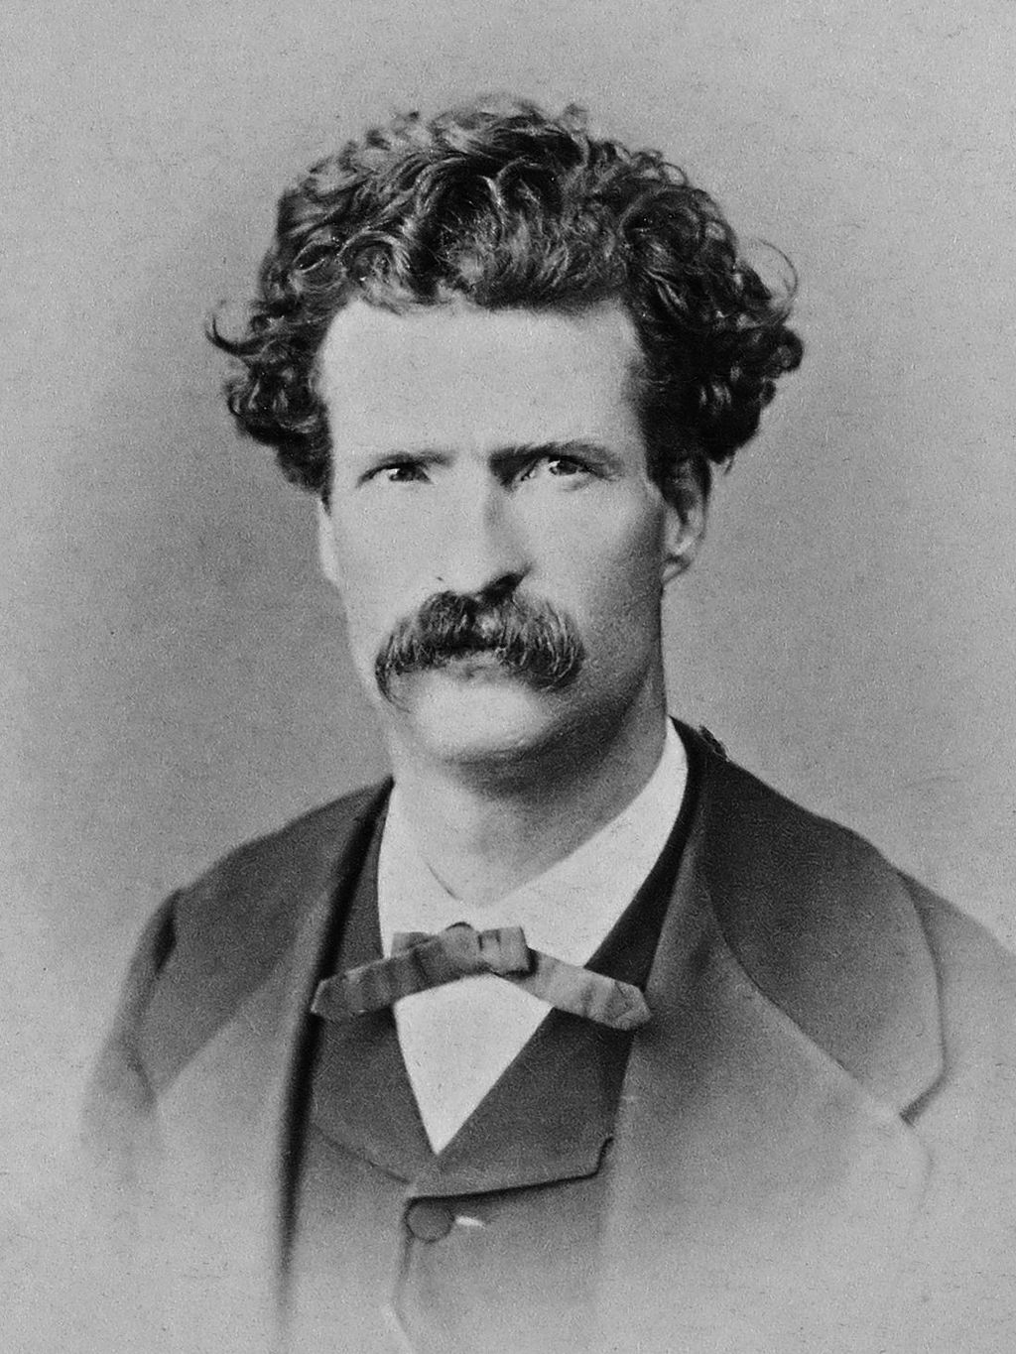
“Thick as Thieves”: Mark Twain and the West’s Spiritual Frontiers
By Dwayne Eutsey
2021 Quarry Farm Symposium:
“150th Anniversary of Roughing It”

Slide 2
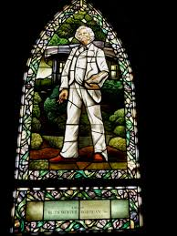
INTRO—Roughing It: Countertheology or Religious Liberalism?
“I have always preached…
If the humor came of its own accord and uninvited, I have allowed it
a place in my sermon, but I was not writing the sermon for the sake
of the humor.”
Mark Twain, Autobiography (1906)

Slide 3
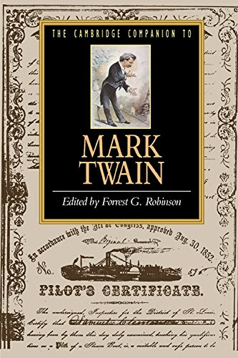
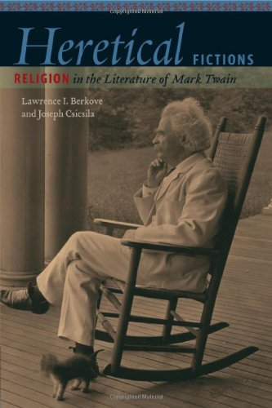
Twain’s “Countertheologies”
Stanley Brodwin
“Mark Twain’s Theology: The Gods of a Brevet Presbyterian” (1995)
Berkove and Csicsila
Heretical Fictions: Religion in the Literature of Mark Twain (2010)

Slide 4
“Deeper Probings” in Roughing It
What can be believed, especially in a new country?
What are the sources of authority?
What are the claims of book learning as opposed to experience?
Harold H. Kolb, Jr.
“Mark Twain and the Myth of the West” (1984)

Slide 5
19th Century Religious Liberalism
Enlightened criticism of religious tradition
The individual’s direct encounter with God
Free Religious Association (1867) sought to liberate religion from “thraldom to irrational and merely traditional authority…” William Potter, FRA co-founder

Slide 6
“Striking Innovation and Creativity in Preaching”
Unitarian ministers at the vanguard
The “literary sermon” was “a freer form of homiletical expression than American Protestantism had yet seen.”
Whitman's oratorical qualities
Melville's moral meditations
Hawthorne's allegories
The Transcendentalist essay
“The Unitarian Movement and the Art of Preaching in 19th Century America”
Lawrence Buell, American Quarterly (1972)

Slide 7
Mark Twain and the West’s Spiritual Frontiers

Slide 8
Frontier Freemasons Twain Befriended
Calvin Higbie in Nevada
James and Steve Gillis in California, Bear Mountain Masonic Lodge No. 76 in Angel’s Camp
Richard Stocker, member of Tuolumne Lodge No. 8 in Sonoma County
Rev. Thomas Starr King, Grand Orator of the Grand Lodge of California
Frontier Liberal Clergy Twain Befriended
Franklin S. Rising, Episcopalian , Nevada, 1862 (Hawaii, 1866)
Thomas Starr King, Unitarian and Universalist, San Francisco, @ 1863
Henry Bellows, Unitarian, San Francisco, 1864
Horatio Stebbins, Unitarian, San Francisco, 1864
Charles Wadsworth, Presbyterian, 1864

Slide 9
Latin and Greek churches met in the valley of the Sonoma
Judaism, in its orthodox and heterodox schools
Christianity, in its Latin, Greek, and Protestant churches
Deism, . . . from that of the devout and considerate Herbert, to that of the blaspheming Paine;
Polytheism…and defiant Mormonism...
“Hence, we should be especially on our guard, doctrinally. . . . we are in danger of, first, liberalism, then indifferentism, finally skepticism . . . .”

Slide 10
“Now if Ormsby votes against the Constitution, let us clothe our selves in sackcloth and put ashes on our heads; for in that hour religious liberty will be at an end here—her next step will be to vote against her eternal salvation.”
Mark Twain, Territorial Enterprise (1864)

Slide 11
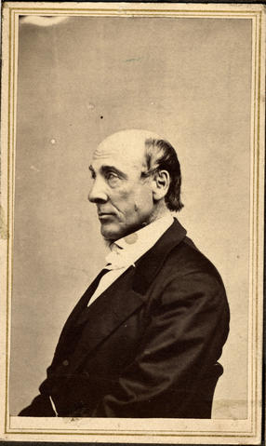
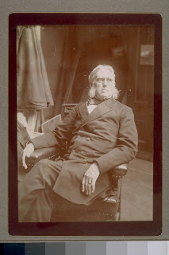
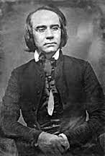
“Thick as Thieves”: 1864-1866
Rev. Henry Bellows
Unitarian
Rev. Horatio Stebbins
Unitarian
Rev. Charles Wadsworth
Presbyterian
“I am thick as thieves with the Rev. Stebbings (sic)…I am running on preachers, now, altogether….Stebbings is a regular brick…Bellows is an able, upright and eloquent man—a man of imperial intellect and matchless power—he is Christian in the truest sense of the term and is unquestionably a brick....” (Twain’s Letter to Family, Dec. 1866)

Slide 12
“Excite the Laughter of God’s Children”
Letter to Orion and Mollie Clemens (1865):
”Powerful ambition” to be a “preacher of the gospel”
Thwarted by ministry’s “stock in trade, i.e. religion”
“Low” literary calling as a humorist to “excite the laughter of God’s children”
Twain Wrote this Letter
After befriending Revs. Rising and King (1862-1864), and
As he became “thick as thieves” with SF progressive clergy (1864-1866)
Gospel vs. Religion

Slide 13
“Real Christianity…is not a system of doctrines”
“Looking at the Word of Jesus, the real Christianity, the pure religion he taught, nothing appears more fixed or certain…
“But looking at the history of what men call Christianity, nothing seems more uncertain and perishable.”
“The Transient and Permanent in Christianity” Theodore Parker (1841)

Slide 14
Franklin Rising vs. A.F. White
Rev. Franklin Rising
“Radical Evangelical”
Preacher of the Gospel
Rev. A.F. White
“Whangdoodle”
Religious Minister
American Church Missionary Society’s purpose was “to preach the gospel…upon the basis of the moderate and liberal principles of our Church.”
Gospel = “…the simple, fundamental life-truths of Christianity, with little symbol, ritual, and legal forms.”
Chaplain, Nevada Territorial Legislature, 1861
Superintendent of Ormsby County schools, 1862–63;
Superintendent of public instruction for the territory/state, 1863–66;
State mineralogist

Slide 15
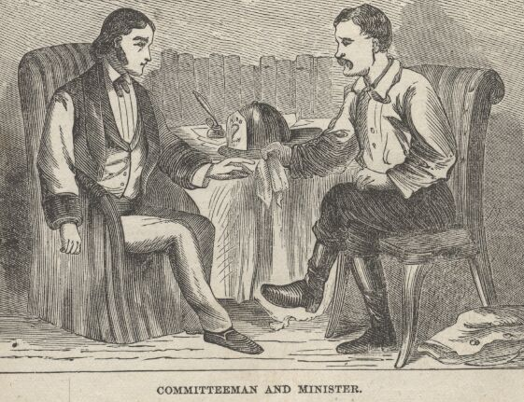
The Fledgling Minister and Scotty Briggs

Slide 16
“Nature is Not Calvinistic”: Thomas Starr King and Roughing It

Slide 17
Rev. Thomas Starr King: “A Great and Good Man”
Unitarian (protégé of T. Parker)
Universalist
Freemason, Grand Orator of CA Lodge
Followed “Emerson in erecting the lecture platform into a kind of free pulpit” Edwin Whipple (1877)
Shared the stage with Artemus Ward at Ward’s request

Slide 18
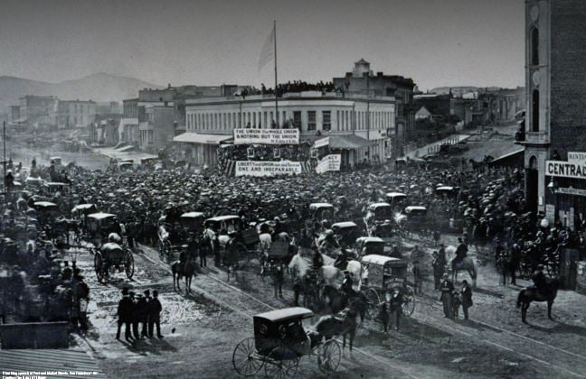
King’s “Great Popularity in California”
The crowd outside a lecture hall where Thomas Starr King was speaking against slavery. Source: Carleton Watkins Collection;
California Historical Society

Slide 19
“Nature is not Calvinistic…”
“God hides his power and veils his awfulness in opulent beauty; and the most ragged and desolate wastes are chosen to display the rarest beauty.”
Thomas Starr King, “Living Water from Lake Tahoe” (1863)

Slide 20
You witness a scene of unrivaled sublimity, and witness the most astonishing sights…tearing up forests in its awful fiery path, swallowing up huts, destroying all vegetation, rioting through shady dells and sinuous canyons.
“Our Fellow Savages of the Sandwich Islands”

Slide 21
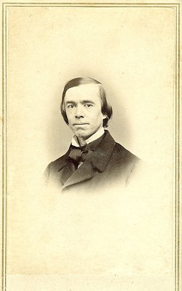
“So all the objects of nature constitute a hieroglyphic alphabet, which states great truths and sentiments that dwell in the Infinite intellect.”
Thomas Starr King, “Substance and Show”

