Slide 1
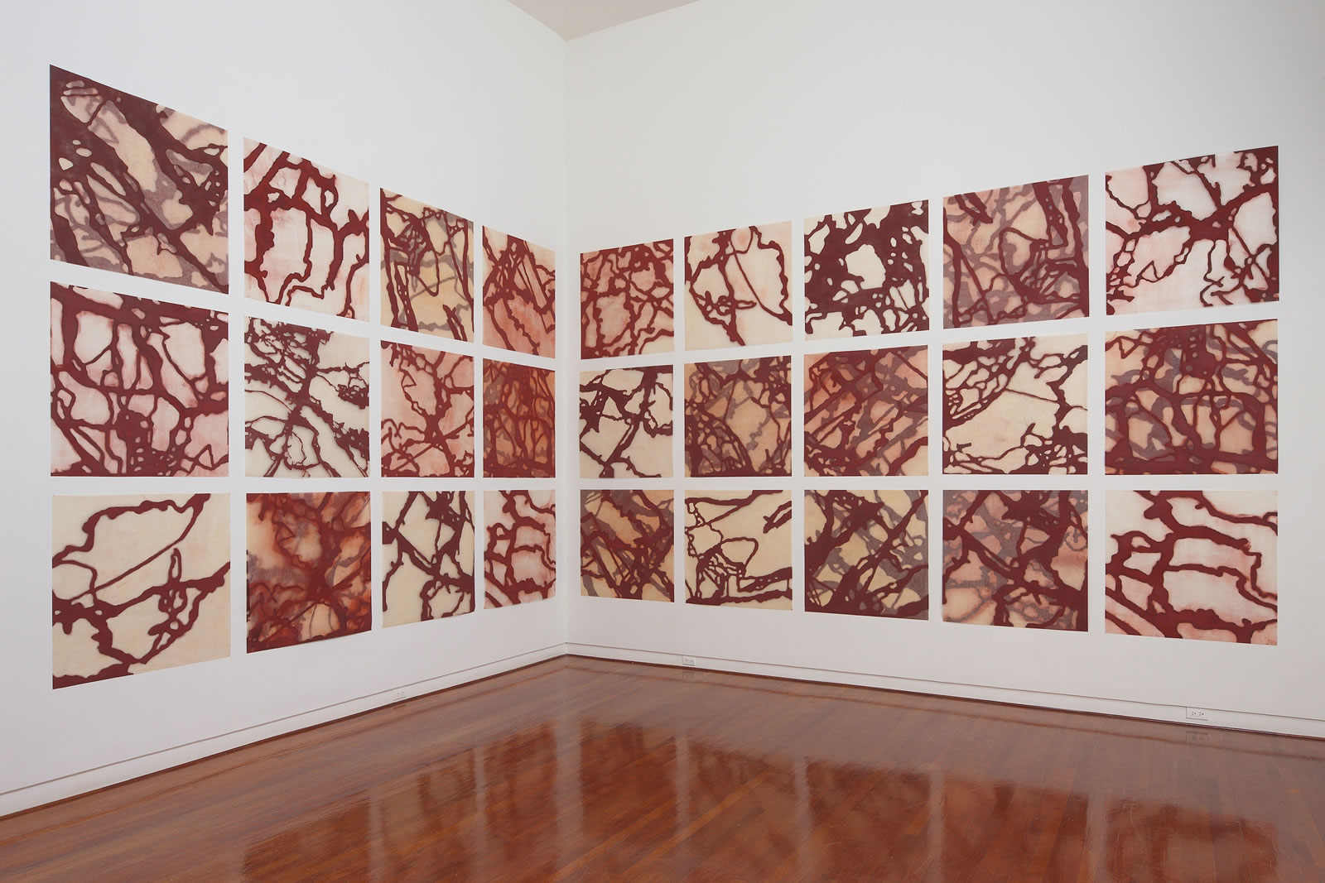
'Now don’t any of you gentlemen get my bones mixed up with yours:' Bodies and Being in the Mark Twain’s Letters from Hawai’i
by Ryan Heryford, PhD, Associate Professor of Environmental Literature, California State University East Bay (ryan.heryford@csueastbay.edu)
Abigail Romanchak, Tracked. The Contemporary Museum Honolulu Exhibition: Biennial IX (2010)

Slide 2
Anthropocene: “a proposed epoch, relating to or denoting the current geological age, viewed as the period during which human activity has been the dominant influence on climate and the environment.” - Will Steffen, et al. Updated Acceleration Graph. “The Trajectory of the Anthropocene” The Anthropocene Review, March 2015
Ontology: the study of being; the study of being human
Epistemology: the study of knowledge; the bodies of knowledge from which we draw to know and be in the world
“This section of the science is properly termed the Epistemology—the doctrine or theory of knowing, just as ontology is the science of being... It answers the general question, 'What is knowing and the known?'—or more shortly, 'What is knowledge?’”- from James Frederick Ferrier’s Institutes of Metaphysics (1854)
Transcorporeality: “does the opposite of distancing or dividing the human from external nature. It implies that we’re literally enmeshed in the physical material world, so environmentalism cannot be an externalized and optional kind of pursuit, but is always present, always at hand.” – from Transcorporeality: An Interview with Stacy Alaimo
Abigail Romanchak, Tracked. The Contemporary Museum Honolulu Exhibition: Biennial IX (2010)

Slide 3
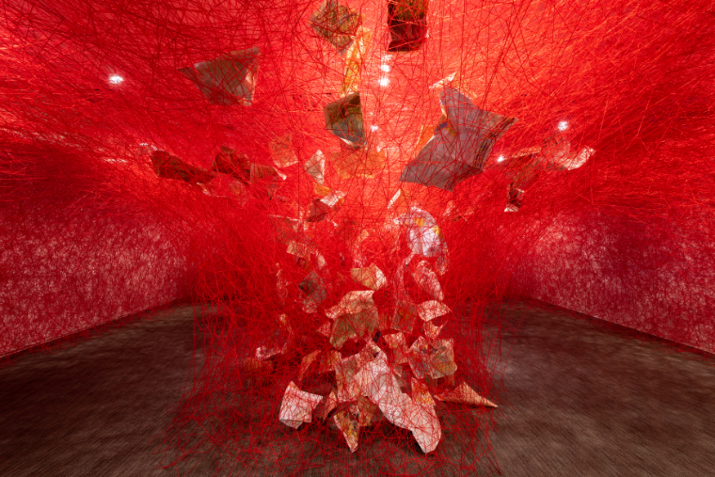
I suppose no man ever saw Niagara for the first time without feeling disappointed. I suppose no man ever saw it the fifth time without wondering how he could ever have been so blind and stupid as to find any excuse for disappointment in the first place. I suppose that any one of nature's most celebrated wonders will always look rather insignificant to a visitor at first, but on a better acquaintance will swell and stretch out and spread abroad, until it finally grows clear beyond his grasp - becomes too stupendous for his comprehension (“The Great Volcano of Kilauea”, November 16th 1866).
Here was room for the imagination to work! You could imagine those lights the width of a continent away - and that hidden under the intervening darkness were hills, and winding rivers, and weary wastes of plain and desert - and even then the tremendous vista stretched on and on and on! - to the fires and far beyond! You could not compass it - it was the idea of eternity made tangible - and the longest end of it made visible to the naked eye! (“The Vision of Hell and Its Angels” November 16th 1866).
Chiharu Shiota, Crossroads. The Contemporary Museum Honolulu Exhibition: Biennial VIII (2009)

Slide 4
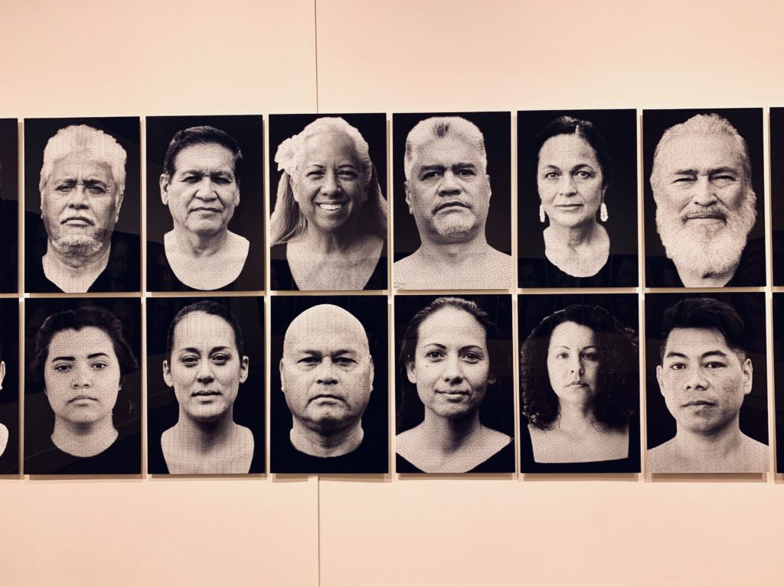
mo‘olelo ku‘una: traditional history; Kanaka Hawaiian literary movement of the 1860s. see: ku'ualoha ho'omanawanui’s Voices of Fire: Reweaving the Literary Lei of Pele and Hi’iaka (2014)
"Ua mau ke ea o ka 'aina i ka pono”: the economy of the land is sovereign, or the sovereignty of the land is perpetuated in righteousness –King Kamehameha III, 1843
ke ea o ke aupuni/the sovereignty of the government
ke ea o ka 'aina/the sovereignty of the land
For further discussion of these translations see: Kanaka ‘Ōiwi Methodologies: Mo’olelo and Metaphor, edited by Katrina-Ann R. Kapā’anaokalāokeola Nākoa Oliveira. (2015)
Kapulani Landgraf, WE ARE NOT AMERICAN—HE HAWAII AU MAU A MAU, The Contemporary Museum Honolulu Exhibition: Biennial VIII (2009)

Slide 5
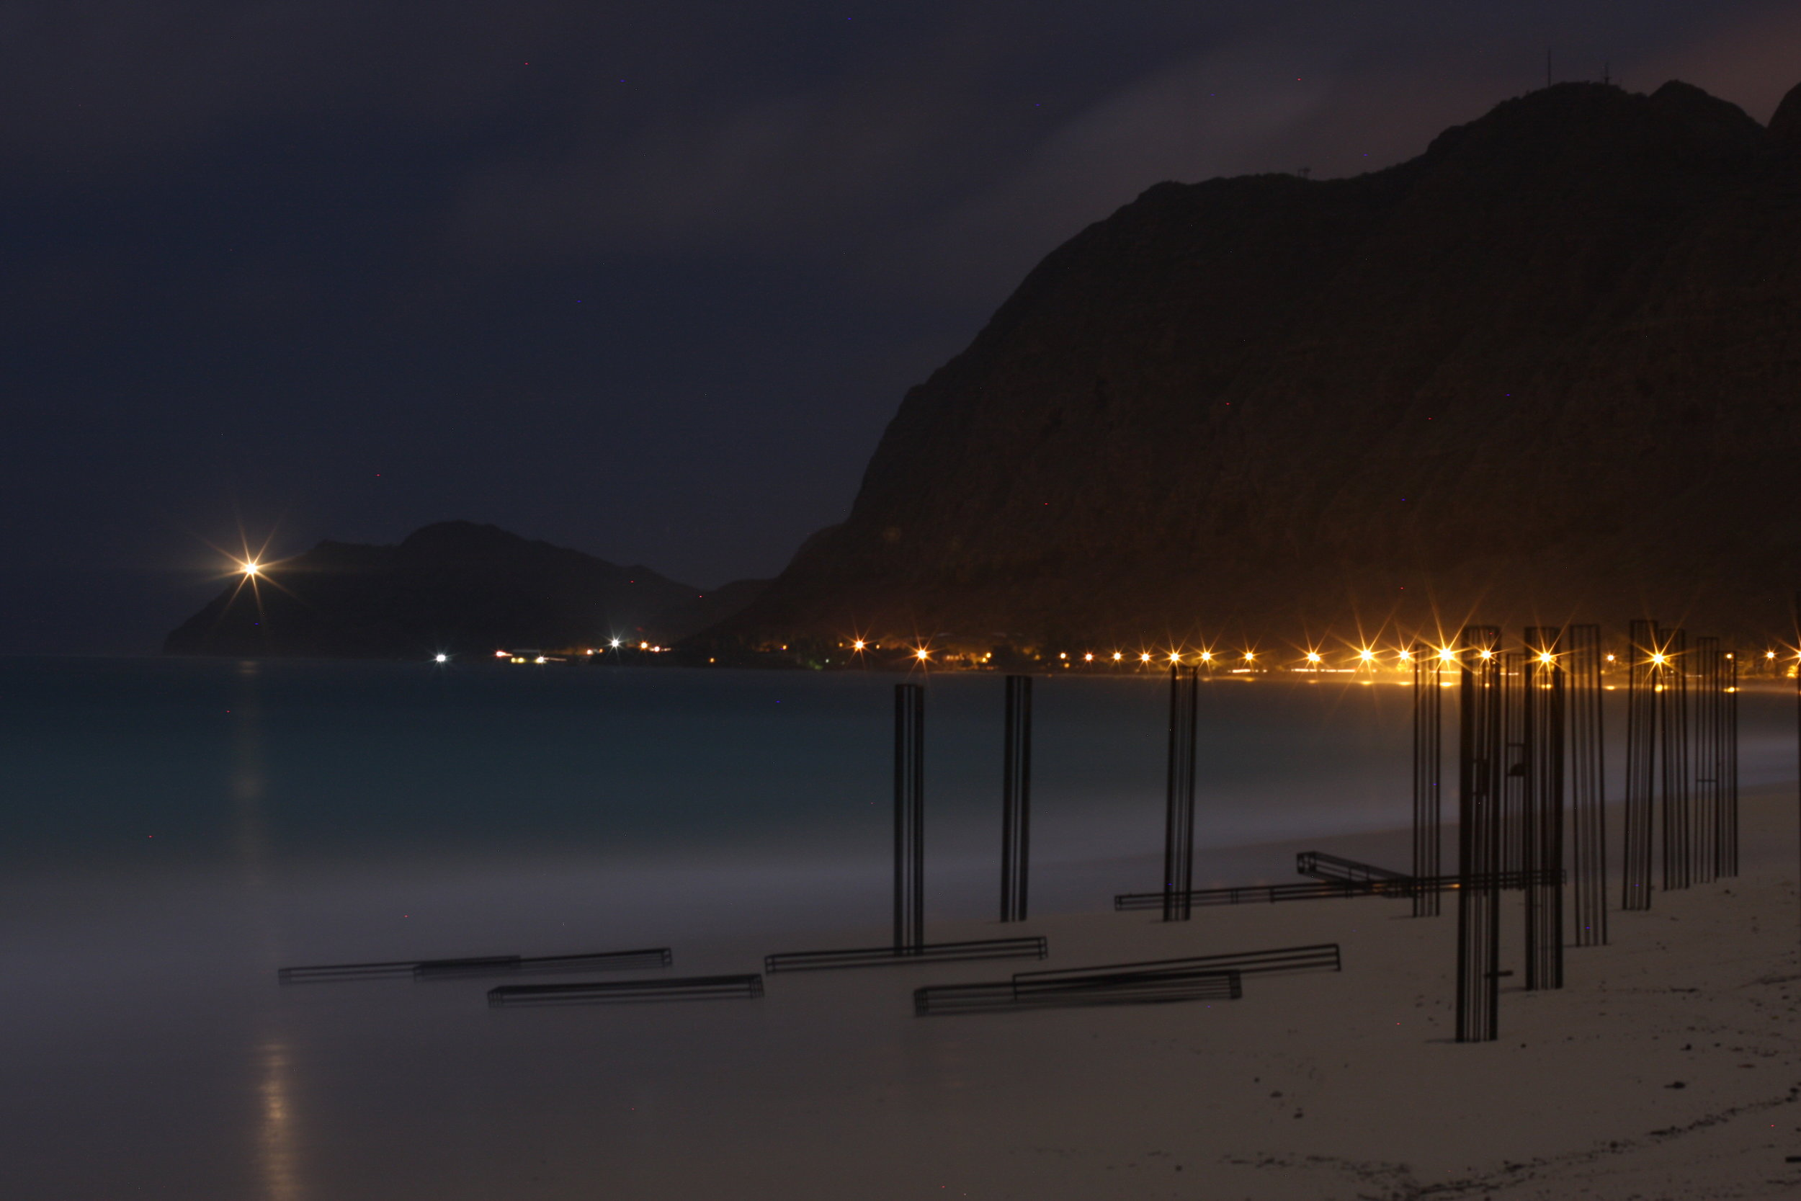
“The moon rose up, and flooded mountain and valley and ocean with silvery light, and I was not sorry we had lately been in trouble, because the consciousness of being safe again raised our spirits and made us more capable of enjoying the beautiful scene than we would have been otherwise. I never breathed such a soft, delicious atmosphere before, nor one freighted with such rich fragrance.” (“The Equestrian Excursion Concluded,” April 24th 1866)
“'Give me some of your bones, Miss Blank; I'll carry them for you.’
Another said:' You haven't got bones enough, Mrs. Blank; here's a good shinbone, if you want it.’
Such observations as these fell from the lips of ladies with reference to their queer newly-acquired property:
'Mr. Brown, will you please hold some of my bones for me a minute?' And, 'Mr. Smith, you have got some of my bones; and you have got one, too, Mr. Jones; and you have got my spine, Mr. Twain. Now don't any of you gentlemen get my bones mixed up with yours so that you can't tell them apart’” (“Battle-Ground Whose History is Forgotten,” April 24th 1866)
Kaili Chun, Veritas (2012)

Slide 6
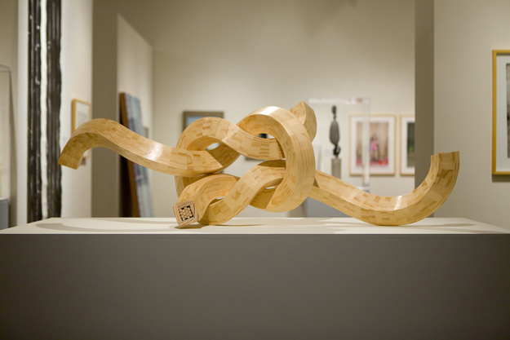
“...the lascivious hula-hula - a dance that is said to exhibit the very perfection of educated motion of limb and arm, hand, head, and body, and the exactest uniformity of movement and accuracy of "time."
It was performed by a circle of girls with no raiment on them so to speak of, who went through with an infinite variety of motions and figures without prompting, and yet so true was their "time," and in such perfect concert did they move that when they were placed in a straight line, hands, arms, bodies, limbs, and heads waved, swayed, gesticulated, bowed, stooped, whirled, squirmed, twisted, and undulated as if they were part and parcel of a single individual; and it was difficult to believe they were not moved in a body by some exquisite piece of mechanism” (“Old Time Saturdays,” May 21st 1866).
Aaron Padilla, Union (pine), Native Artists of Hawai’i, Honolulu Academy of the Arts (2011)

Slide 7
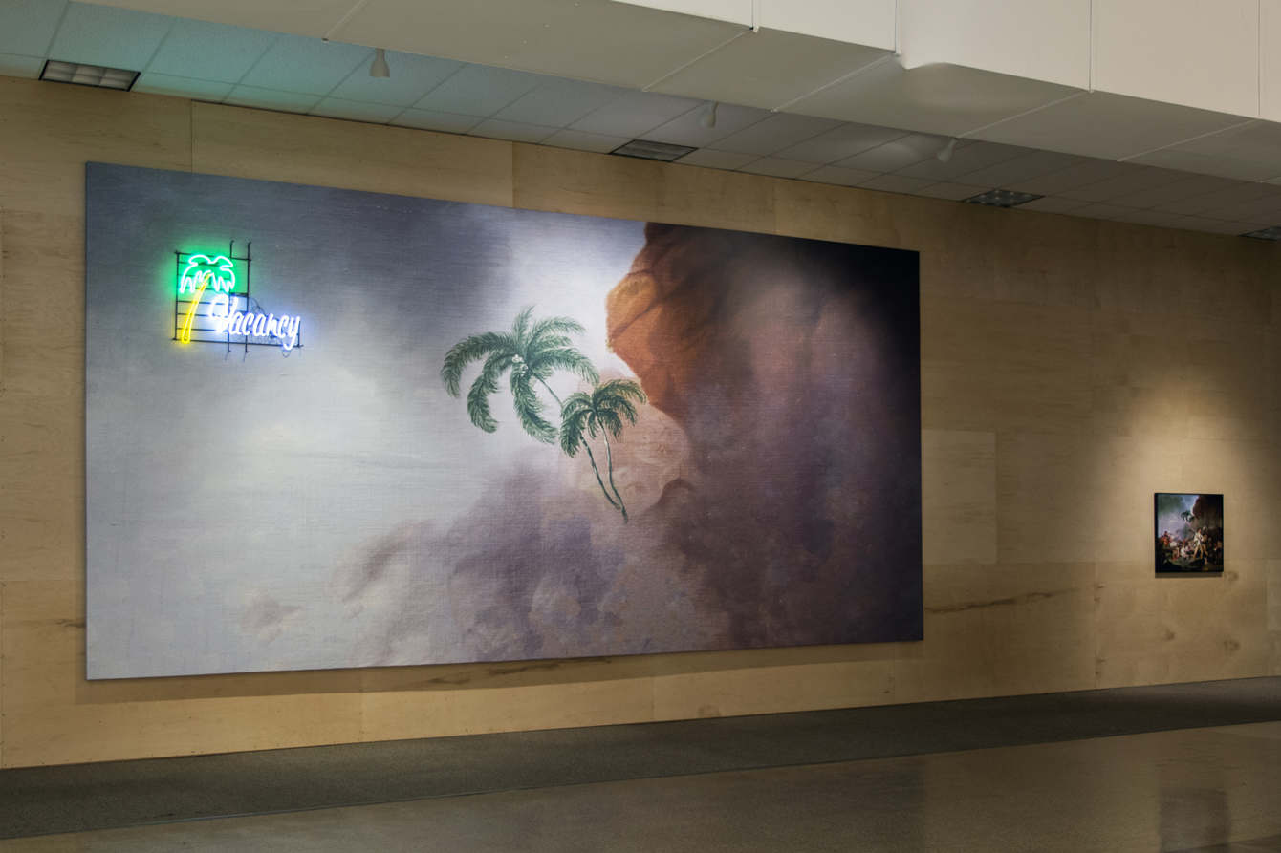
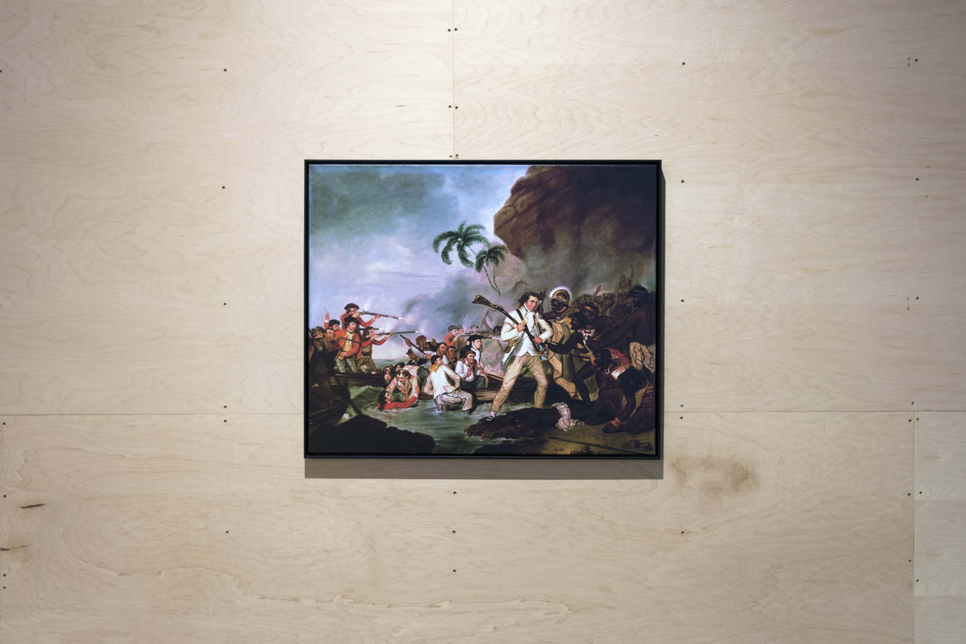
All day long one has this monotony of dust-colored dead levels and scattering bunches of trees and mud villages. You soon realize that India is not beautiful; still there is an enchantment about it that is beguiling, and which does not pall. You cannot tell just what it is that makes the spell, perhaps, but you feel it and confess it, nevertheless. Of course, at bottom, you know in a vague way that it is history, it is that that affects you, a haunting sense of the myriads of human lives that have blossomed, and withered, and perished here, repeating, century after century, and age after age, the barren and meaningless process; it is this sense that gives to this forlorn, uncomely land power to speak to the spirit and make friends with it; to speak to it with a voice bitter with satire, but eloquent with melancholy. The deserts of Australia and the ice-barrens of Greenland have no speech, for they have no venerable history; with nothing to tell of man and his vanities, his fleeting glories and his miseries, they have nothing wherewith to spiritualize their ugliness and veil it with a charm (Following the Equator 721).
Drew Kahuʻāina Broderick, Billboard I (The sovereignty of the land is perpetuated in righteousness) (Honolulu Biennial, 2017)

Slide 8
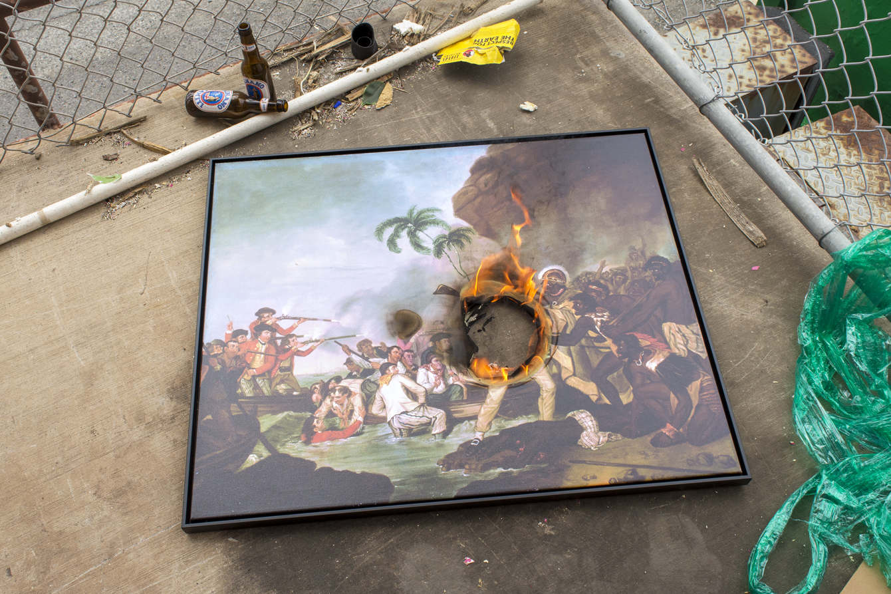
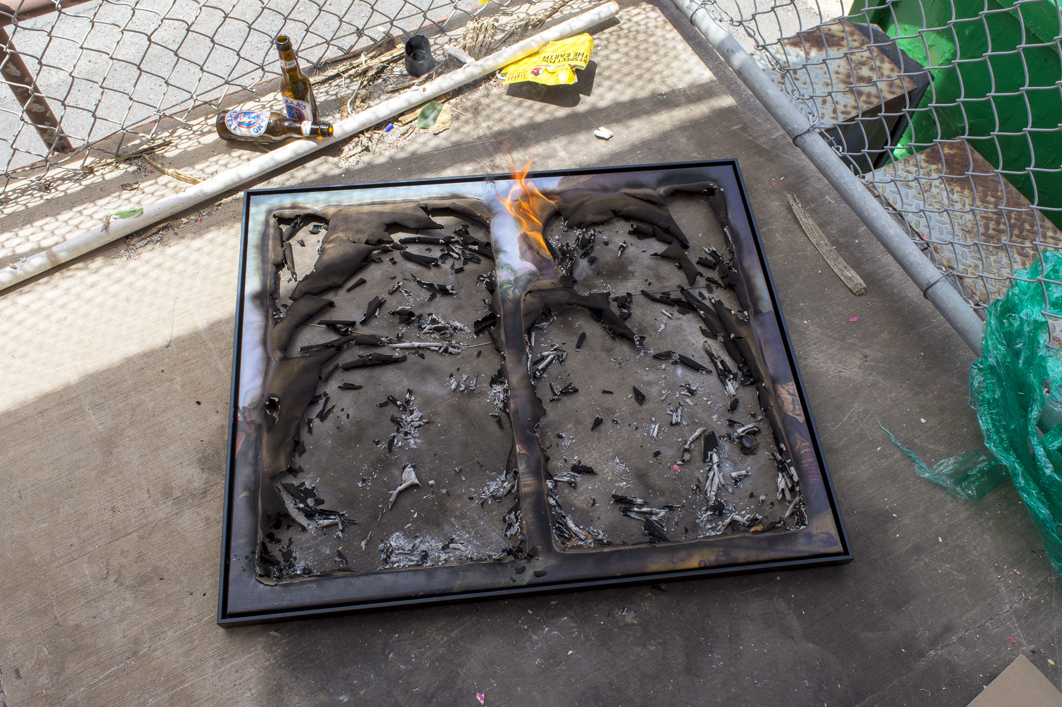
...up on the mountain side we had passed by a large inclosure like an ample hogpen, built of lava blocks, which marks the spot where Cook's flesh was stripped from his bones and burned; but this is not properly a monument, since it was erected by the natives themselves, and less to do honor to the circumnavigator than for the sake of convenience in roasting him. A thing like a guideboard was elevated above this pen on a tall pole, and formerly there was an inscription upon it describing the memorable occurrence that had there taken place; but the sun and the wind have long ago so defaced it as to render it illegible (“Great Britian’s Queer Monument to Captain Cook,” August 30th 1866).
“In accordance with the Bishop Museum's loan agreement, the 1:1 reproduction of George Carterʻs Death of Captain Cook (c. 1783) was destroyed at the end of the event, and its destruction to be documented as "proof". – Drew Kahuʻāina Broderick

Slide 9
