Slide 1
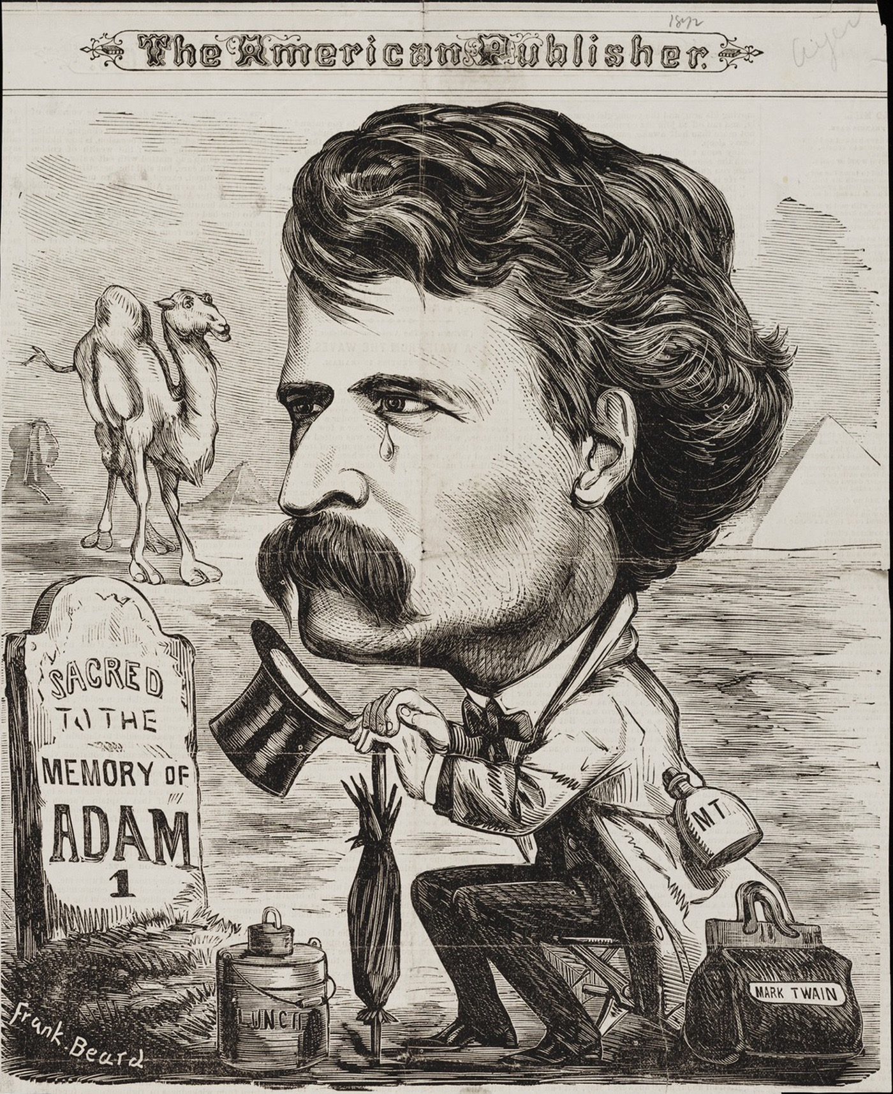
Material Sanctity: Salvaging the Sacred in The Innocents Abroad
Merav Schocken
University of California, Santa Barbara

Slide 2
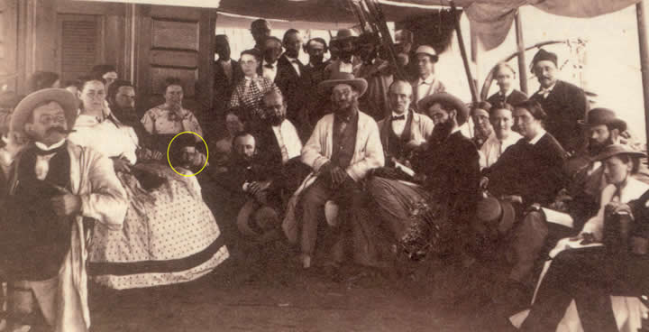
Quaker City Steamship
Mark Twain (circled) and his fellow travelers aboard the Quaker City

Slide 3
On Palestine:
“Palestine sits in sackcloth and ashes. Over it broods the spell of a curse that has withered its fields and fettered its energies...Palestine is desolate and unlovely.”
Innocents Abroad (1869)
Catherine Tobin (1903)

Slide 4
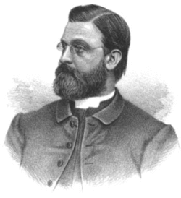
James DeKoven, “The Gates of the Invisible” (1878)
“The miracles of one age become the science of another. Law after law is discovered; what we once thought the direct working of the Father of all proves to be a mighty force…”

Slide 5
James DeKoven, “The Gates of the Invisible” (1878)
“The voice that seemed to say, ‘Thus far shalt thou come, and no farther,’ recedes and recedes. Between us and God appear to come laws, and forces, and powers, the duration and extent of which we can grasp and measure. The visible encroaches on the invisible. What, then, if these laws begin to take to us the place of God?”

Slide 6
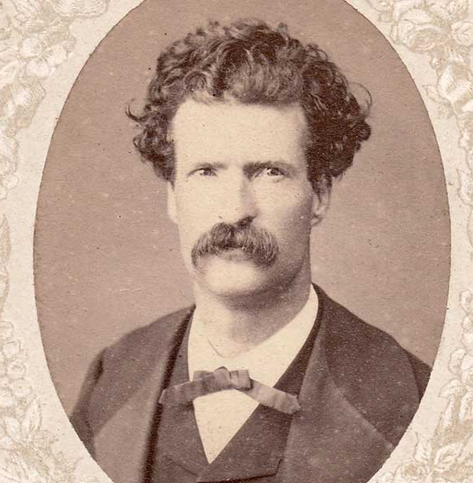
Twain’s letter to his brother (1865):
“You are in trouble, & in debt—so am I. I am utterly miserable—so are you. Perhaps your religion will sustain you, will feed you—I place no dependence in mine. Our religions are alike, though, in one respect—neither can make a man happy when he is out of luck. If I do not get out of debt in 3 months,—pistols or poison for one—exit me.”

Slide 7
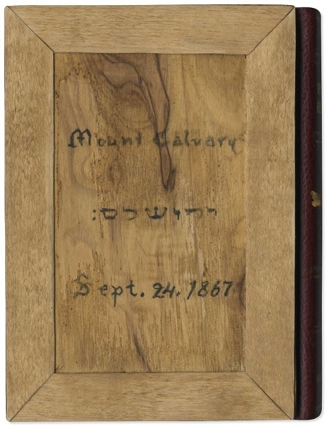
Holy Land in American Imagination
The Holy Land was "infused with emotional and sentimental associations. As an emotional idea, it was powerfully bound with other idealisms held quite close to many hearts: the bible, one's church, and even one's home, for frequently the emotions that arose within many were of the sweetest associations of youth and hearth, of bible stories and fireside readings.”
Lester I. Vogel, To See a Promised Land (1993)
Replica of the Bible Twain purchased in Jerusalem for his mother.
Shapell Manuscript Foundation.

Slide 8
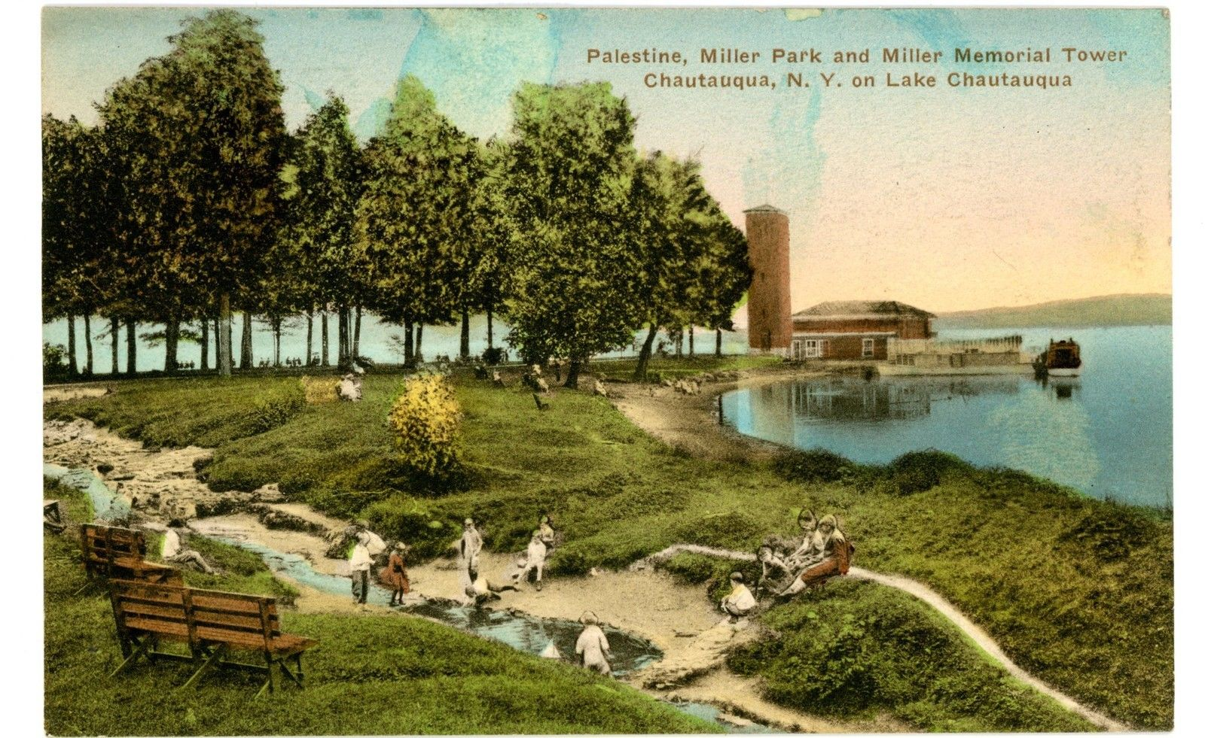
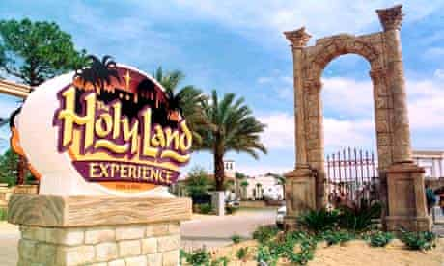
Holy Land in American Imagination
The main entrance to "The Holy Land Experience" theme park in Orlando, Florida. Photo: Kevin Wisniewski/Rex Features
Palestine Park in Chautauqua, New York

Slide 9
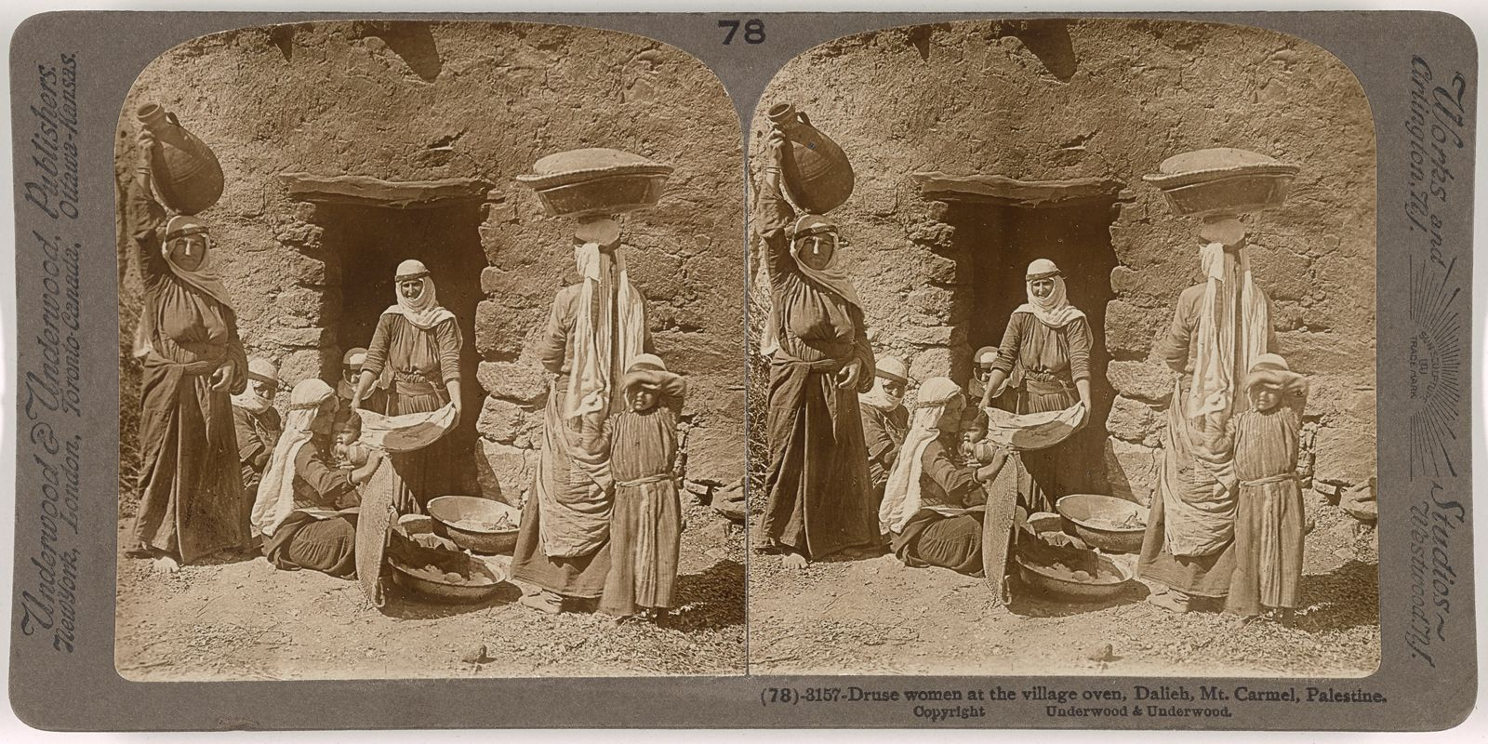
Stereographic Tours
Jesse Lyman Hurlbutt, "Druse women at the village oven, Dalieh, Mount Carmel, Palestine" (1900)

Slide 10
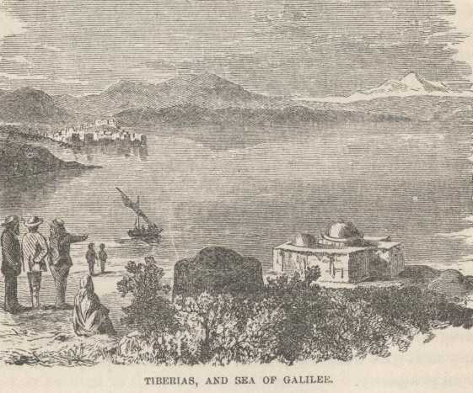
Sea of Galilee
“I can not comprehend yet that I am sitting where a god has stood, and looking upon the brook and the mountains which that god looked upon...I can not comprehend this; the gods of my understanding have been always hidden in clouds and very far away.”
Innocents Abroad

Slide 11
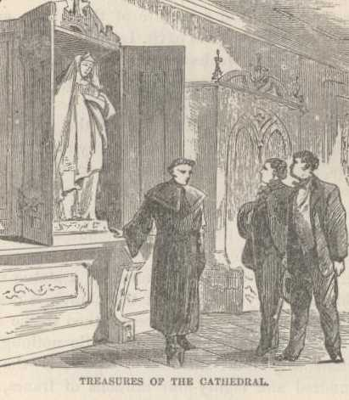
On Catholic Practices in European Churches:
In Genoa: “But isn’t this relic matter a little overdone? We find a piece of the true cross in every old church we go into, and some of the nails that held it together.”
In Italy: “We were in the heart and home of priest craft--of a happy, cheerful, contented ignorance, superstition, degradation, poverty, indolence, and everlasting unaspiring worthlessness.”
The relics are “Jesuit humbuggery.”
Innocents Abroad

Slide 12
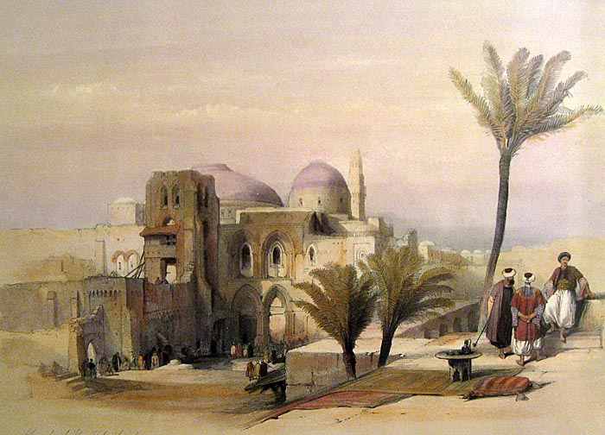
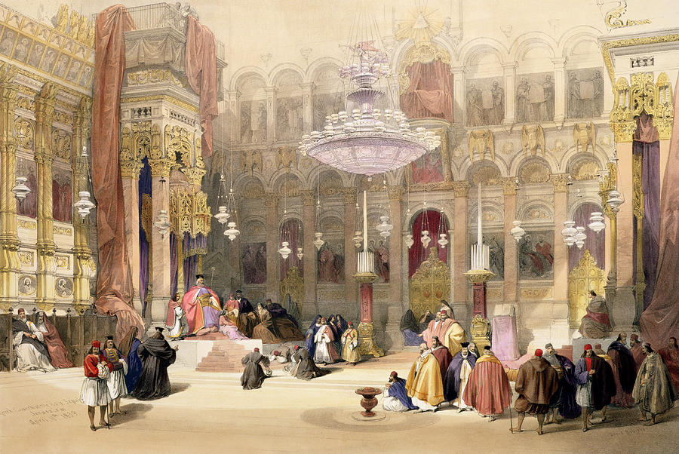
The Church of the Holy Sepulchre
“Exterior of the Holy Sepulchre,” David Roberts (1841)
“Greek Church Of The Holy Sepulchre,” David Roberts (1839)

Slide 13
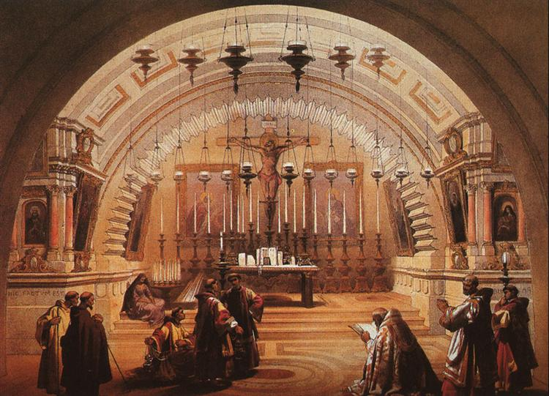
Twain on Church of Holy Sepulchre:
One “fully believes that he is looking upon the very spot where the Savior gave up his life.”
“To publicly execute such a personage was sufficient in itself to make the locality of the execution a memorable place for ages.”
“Fathers would tell their sons about the strange affair, and point out the spot; the sons would transmit the story to their children, and thus a period of three hundred years would easily be spanned.”
“It is not possible that there can be any mistake about the locality of the Crucifixion.”
“Calvary,” David Roberts (1839)
Innocents Abroad

Slide 14
Jenny Franchot: “The Bodily Gaze of Protestantism”
“[I]ssues of the body, of church architecture, of art, and of food converged to form a distinctive Protestant gaze on Rome, a gaze that acknowledged [Catholicism's] spiritual desire, celebrated Catholicism as spectacle, and fantasied the consumption of this foreign substance rather than conversion to it.”
Roads to Rome: The Antebellum Protestant Encounter with Catholicism (1994)

Slide 15
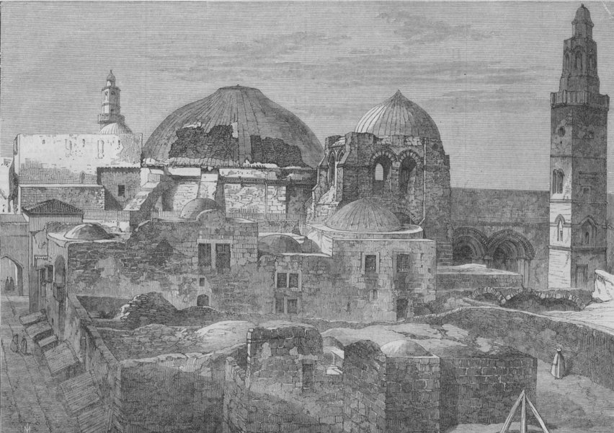
Melville on Church of Holy Sepulchre:
Broken dome —Anointing stone lamps — dingy, —queer smell…"
”Here almost every day I would hang, looking down upon the spectacle of the scornful Turks on the divan, & the scorned pilgrims kissing the stone of the anointing.”
Journals (1857)
"The Latin church of the Holy Sepulchre at Jerusalem" from Illustrated London News (1865)

Slide 16
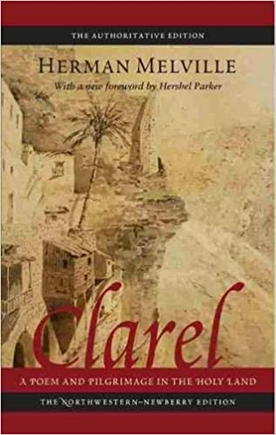
Melville on Church of Holy Sepulchre:
“[T]is here/ they scourged Him; soldiers yonder nailed / The victim to the tree; in jeer / There stood the Jews; there Mary pales; the vesture was divided here.”
“A miracle play of haunted stone--/ A miracle play, a phantom one.”
Clarel (1876)

Slide 17
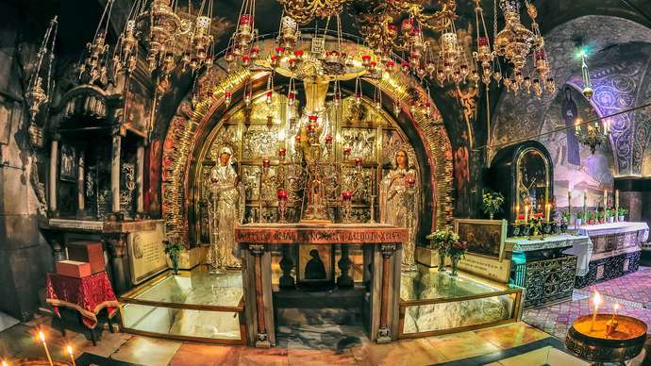
The Altar of the Crucifixion at the Church of the Holy Sepulchre. Photo: Alexandr Makarenko

Slide 18
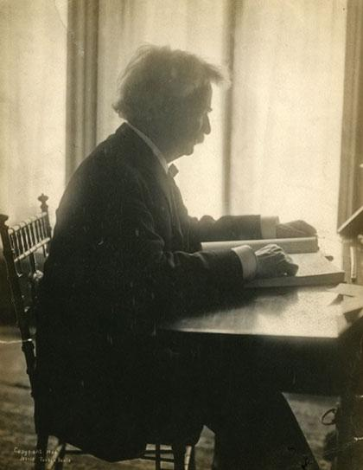
Reflections on Travel
“We are at home again. We are exhausted…We have full comfort in one reflection, however. Our experiences in Europe have taught us that in time this fatigue will be forgotten…and then, all that will be left will be pleasant memories of Jerusalem, memories we shall call up with always increasing interest as the years go by, memories which some day will become all beautiful when the last annoyance that incumbers them shall have faded out of our minds never again to return…We are satisfied. We can wait. Our reward will come. To us, Jerusalem and to-day's experiences will be an enchanted memory a year hence—memory which money could not buy from us.”
Innocents Abroad
Photo: Jessie Tarbox Beals (c. 1906)

