Slide 1
Mark Twain’s Historical Fiction; or, Why Would a Realist Write So Many Romances?
Nathaniel Cadle
Associate Professor of English
Florida International University

Slide 2
Mark Twain: Tom Sawyer and Huck Finn (Norman Rockwell, 1936; Thomas Hart Benton, 1936)

Slide 3
Wikipedia entry for “Mark Twain,” first paragraph, 2019

Slide 4
Also Mark Twain: King Arthur and Joan of Arc (Life Magazine, Dec. 24, 1903; Library of America, 1994)

Slide 5
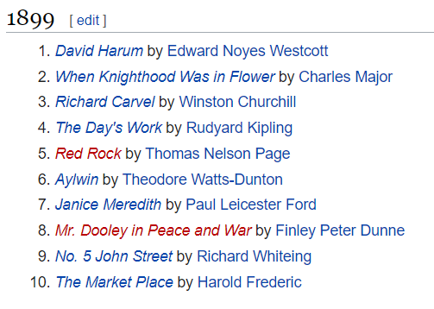
The enormous popularity of so many romances led to the first bestseller lists in the mid-1890s.

Slide 6
Bestsellers throughout 1900, listed in January 1900 issue of The Bookman (originator of bestseller lists)

Slide 7
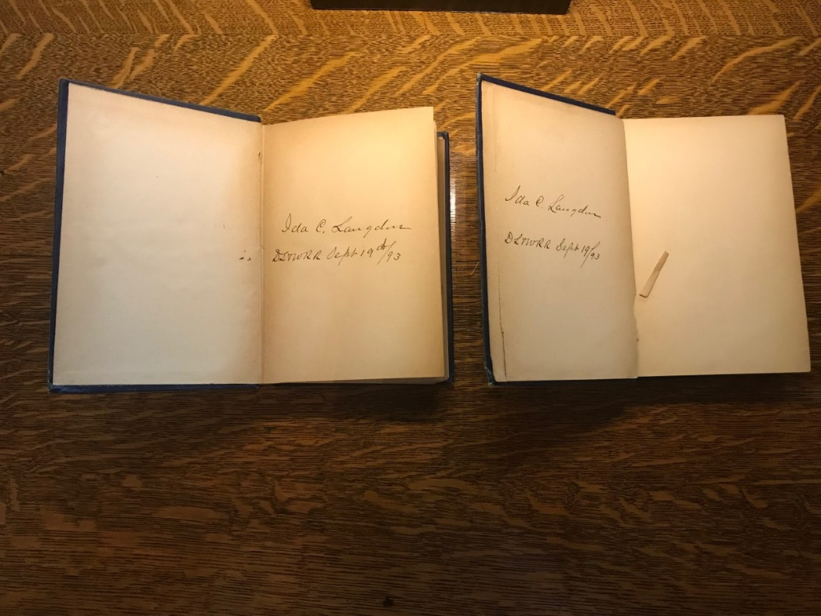
The Langdons owned novels by S. Weir Mitchell and Lew Wallace during Twain’s lifetime.

Slide 8
And Twain often helped himself to others’ libraries….
During an August 1890 interview conducted at Quarry Farm by (coincidentally) Rudyard Kipling, Twain “pointed to an encyclopædia on the shelves—‘I was reading an article about “Mathematics.” Perfectly pure mathematics.’”
— Rudyard Kipling, From Sea
to Sea (1899), p. 180
At right, Jervis Langdon’s set of The English Cyclopædia (1866)

Slide 9
Debates about the relative merits of realism and romance (the “realism war”) helped practitioners define their own aesthetic commitments.
Realists (Howells, Garland, James):
emphasized the probable, the typical, the local, the observable
valued characterization, atmosphere, and prose style (because the main interest was not incident)
argued that fiction affirmed or expanded readers’ sense of humanity, or drew attention to social problems
idolized Tolstoy (and maybe Zola), hated Haggard
Romancers (Stevenson, Crawford, Catherwood):
emphasized the improbable, the fantastic, the exotic/distant
valued inventiveness of plot and old-fashioned storytelling
argued that fiction amused or comforted readers, or inspired readers with better versions of themselves
idolized Stevenson, hated Zola (and resented Howells’ role as critic-gatekeeper)

Slide 10
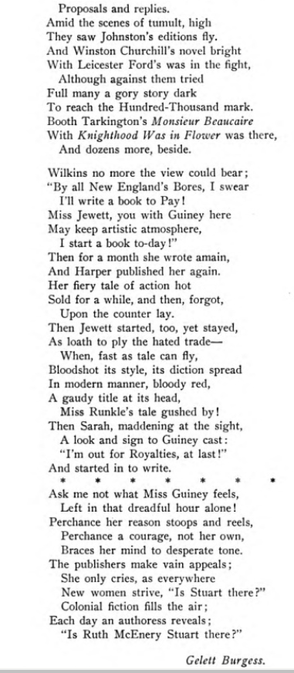
In fact, so noticeable had the realists’ interest in writing romance become that the January 1901 issue of The Bookman contained a comic poem about the phenomenon, written by Gelett Burgess.

Slide 11
Between 1900 and 1920, the Romantic Revival was considered an important enough literary phenomenon that it appears regularly in literary histories.
Bliss Perry’s A Study of Prose Fiction (1903)
Carl Van Doren’s The American Novel (1921)

Slide 12
1. Realists believed that an evolutionary process was at work in literary history, and that romance had had its day and was no longer viable.
“A distinct evolution is traceable in fiction from the earliest ages of which history has left a record. Children and barbarians delight in supernatural tales, and the more horrible they are the better. […] Some time during the eighteenth century a new style of fiction, originating in England, spread with astonishing rapidity over all Europe[, …] dealing with improbably but rarely impossible adventures in remote and undiscovered climes. […] We are now taking the step from the possible to the probable, nay, we are even going beyond this and demanding that the novel shall deal with the normal and typical. […] However popular and profitable romanticism may yet be, I can scarcely doubt that the tendency of the age is toward a more and more unflinching realism.” — H.H. Boyesen, “The Romantic and the Realistic Novel,” The Chautauquan, November 1888

Slide 13
2. Realists believed that wildly popular fiction tended to serve anti-intellectual purposes.
“Our literature is almost entirely addressed to the appetite for romance and adventure, probable or improbable, to sentimentalism, to theoretical interest in crime, marital infelicity, and personal misfortune, and to the pleasure of light emotional excitement, while a large part of it turns on ethical emotion and ignorant zeal in social matters. […] The predominance of the emotional element in popular literature means that people are trained by it away from reality. They lose the power to recognize truth. […] They are made day-dreamers, or philistines, or ready victims of suggestion, to be operated upon by religious fakers, or politicians, or social innovators. What they need is criticism.”—William Graham Sumner, “The Scientific Attitude of Mind,” 1905 speech

Slide 14
3. Realists believed that romantic literature in particular served conservative, politically problematic ends.
“Then comes Sir Walter Scott [after the French Revolution and its Enlightenment ideals] with his enchantments, and by his single might checks this wave of progress, and even turns it back; sets the world in love with dreams and phantoms; with decayed and swinish forms of religion; with decayed and degraded systems of government. […] It was Sir Walter that made every gentleman of the South a major or a colonel, or a general or a judge, before the war; and it was he, also, that made these gentlemen value these bogus decorations. For it was he that created rank and caste down there, and also reverence for rank and caste, and pride and pleasure in them. Enough is laid on slavery, without fathering upon it these creations and contributions of Sir Walter.”—Mark Twain, Life on the Mississippi (1883)

Slide 15
Subsequent scholars have largely agreed with the realists’ assertions, sometimes explicitly.
Marxist critic Georg Lukács’ influential study The Historical Novel (1937) argues that the vitality of historical fiction (probably the most popular genre revived by late-nineteenth-century romanticists) was tied to a particular historical moment in the early nineteenth century and that later attempts to revive it are “decadent.”
Amy Kaplan’s new historicist study of the romantic revival in The Anarchy of Empire in the Making of U.S. Culture (2002) links the resurgent popularity of romantic adventure stories to the U.S. government’s increasing interest in acquiring territory overseas, leading up to the Spanish-American War and annexation of the Philippines. (Kaplan cites Howells’ similar argument from 1900.)

Slide 16
Are the popular romances of the period as bad—or as bad for you—as these critics say?
“I marked the light die from the broad bosom of the river, leaving it
a dead man's hue. Awhile ago, and for many evenings, it had been
crimson,--a river of blood. A week before, a great meteor had shot
through the night, blood-red and bearded, drawing a slow-fading fiery
trail across the heavens; and the moon had risen that same night
blood-red, and upon its disk there was drawn in shadow a thing most
marvelously like a scalping knife.” — The opening paragraph of Mary
Johnston’s To Have and to Hold (1900)

Slide 17
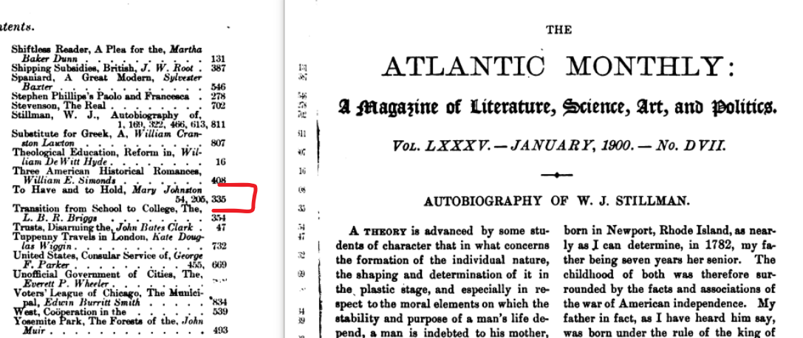
As Patricia Okker has pointed out (1994), To Have and to Hold was serialized in the Atlantic Monthly at the same time as Zitkala-Ša’s memoirs, thereby effectively drowning out an authentic Native American voice.

Slide 18
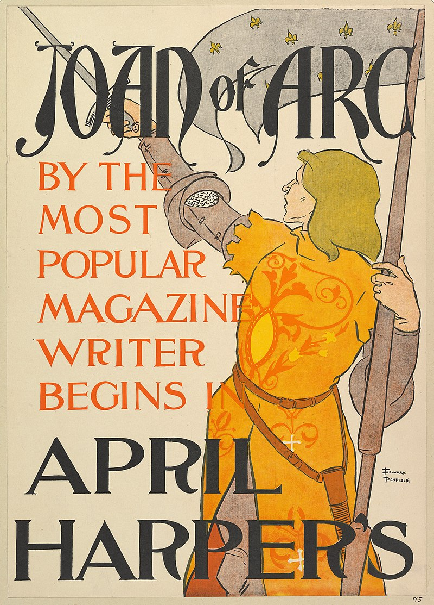
1. Realists were cashing in on a popular literary trend, or were simply piqued to try their hands.
This is the explicit message expressed in Burgess’ poem:
“Sadly did Mary Wilkins say,
“‘No more does Realism pay!’”
It might also explain Twain’s decision to serialize Joan of Arc anonymously, giving him freedom to do something different.

Slide 19
2. Several authors adopted the Romantic mode in order to subvert it.
Twain’s Connecticut Yankee (1889) is the representative example, burlesquing the conventions compiled in Thomas Malory’s Le Morte d’Arthur (1485) and seemingly responding directly to Scott’s to Southern plantation system by turning it on its head and having King Arthur and Hank enslaved themselves.
Even more subversive is Edward Bellamy’s The Duke of Stockbridge (1879, 1900), which depicts the American Revolution as a failure because it reinforces the economic power local landowners hold over tenet farmers. The hero doesn’t come remotely close to “getting the girl” and, at the end, is shot dead while taking part in Shays’ Rebellion.

Slide 20
3. A handful of realists sensed that thoughtful engagement with romance could lead to literary innovation.
The most famous example is the indeterminacy of Henry James’ The Turn of the Screw, which famously can be read either as a genuine ghost story or as the depiction of a sexually repressed young woman’s descent into madness. James’ adept use of the conventions of Gothic and sensation fiction and his carefully controlled use of perspective allows for either interpretation.
Edmund Wilson starts with The Turn of the Screw in his classic essay “The Ambiguity of Henry James” (1934), which helped to establish James as a proto-modernist and contributed to the perception that ambiguity is a mark of literary excellence.

Slide 21
Notably, these efforts at engaging romance align with the most sophisticated defense of the Romantic Revival:
“The popular romances, at least the very best of them, show a regard for reality—verisimilitude—[and seem] to authenticate improbability and identify what might easily have been rejected as unknown in experience. […] It suggests the possibility that art may be making its way through an ancient barrier to a channel in which the best of what we know as realism and the highest essentials of imaginative vigor [i.e., romance] may join and combine for a new and great revival of true greatness in the novel.” — Maurice Thompson, “The Prospect in Fiction,” The Independent, 17 May 1900.

Slide 22
Thompson is rejecting the evolutionary view of literary history and arguing that literature develops dialectically.
In this respect, Thompson anticipates a famous conception of cultural development articulated by Raymond Williams in Marxism and Literature (1977):
Williams Thompson
Residual Structures of Feeling = (Romance)
Dominant Structures of Feeling = (Realism)
Emergent Structures of Feeling = (Modernism…?)

Slide 23
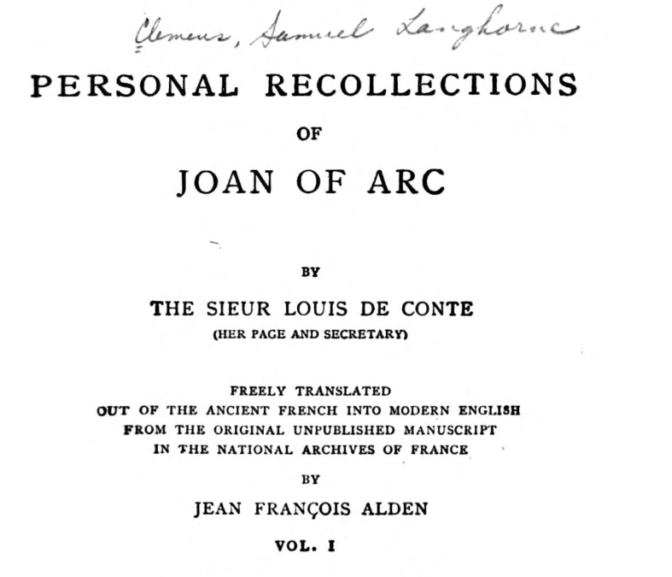
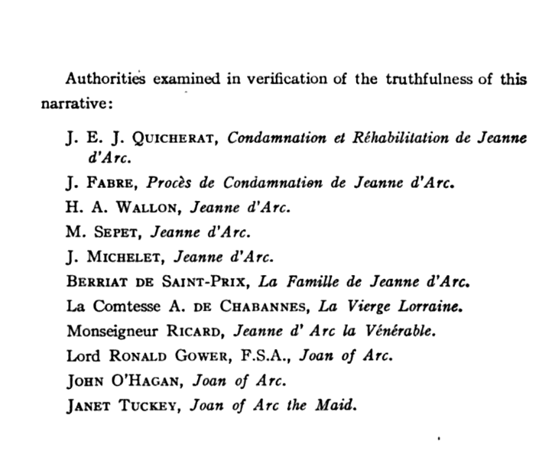
Twain’s Joan of Arc as Realism:
Extensive “editorial apparatus”
Psychological explanation:
“‘France will rise again. You shall see. [… The King] will wear his crown. […] Both will have happened before two years are sped.’
“It was inevitable that I should think of madness.”

Slide 24
Twain’s Joan of Arc as Romance:
Twain immediately subverts that psychological explanation and reaffirms the fantastic/supernatural explanation:
“And now I saw a most strange thing, for I saw a white shadow come slowly gliding along the grass toward the tree. […] ‘You were not dreaming when you cut the mark in the tree.’ […] Now I knew of a certainty that I had not been dreaming, but had really been in the presence of a dread something not of this world.”
Twain include sentimental scenes, without irony:
“The two girls said their good-byes, clinging about each other’s neck, and pouring out their grief in loving words and tears, a pitiful sight to see.”

Slide 25
Twain’s Joan of Arc as Modernism (?):
It is a novel that simultaneously obscures and reveals its own author’s presence. Despite being published anonymously,
1. The initials of the narrator (S.L.C.) are Twain’s own.
Claiming to be written in 1492 (an unmistakably important date for the Americas), the narrative immediately refers to the invention of printing.
The novel contains much of Twain’s characteristic irony but omits an ironic “stranger” character (Hank, Satan), thereby shifting responsibility for perceiving that irony to the reader:
“‘I know him, and have known him long; and he knows me. I have fed him through the bars of his cage many times; and last December when they chopped off two of his fingers to remind him to stop seizing and wounding people passing by, I dressed his hand every day till it was well again.’”

